Slide 1
AI Powered MediKit
An AI System with Miscellaneous Medical Applications

Slide 2
PROBLEM STATEMENT WE CHOSE
Challenge of healthcare accessibility in Rural India
Services are predominantly available in urban areas
Accessible healthcare to rural & remote regions is difficult
Many patients in these areas lack access to reliable telehealth services
Focus is on ensuring the reliability of medical services in rural India
Introducing A Collective Medical Kit solving umpteen problems
It can be evolved into A Robotic Agent in Future

Slide 3
WHAT WE SOLVE?
The medical field generates data with subtle patterns
Conventional machine learning architectures, such as CNN struggle
Inaccurate predictions and potentially mislead patients
Retraining models with new data is not ideal
Proposed solution leverages state-of-the-art machine learning architectures to overcome these challenges

Slide 4
KEY FEATURES
Using ViT, Classification of Subtle Features
Few-shot Classification of Tablets
Text Similarity Search for Herbal Solutions
MFCC based Heart-Beat Classification
Text Similarity powered Medical Chatbot

Slide 5





TECHNOLOGIES USED
We do Deep Learning Through the following Libraries!

Slide 6

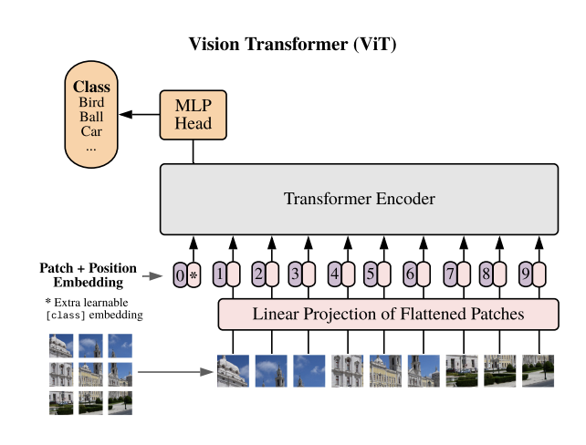
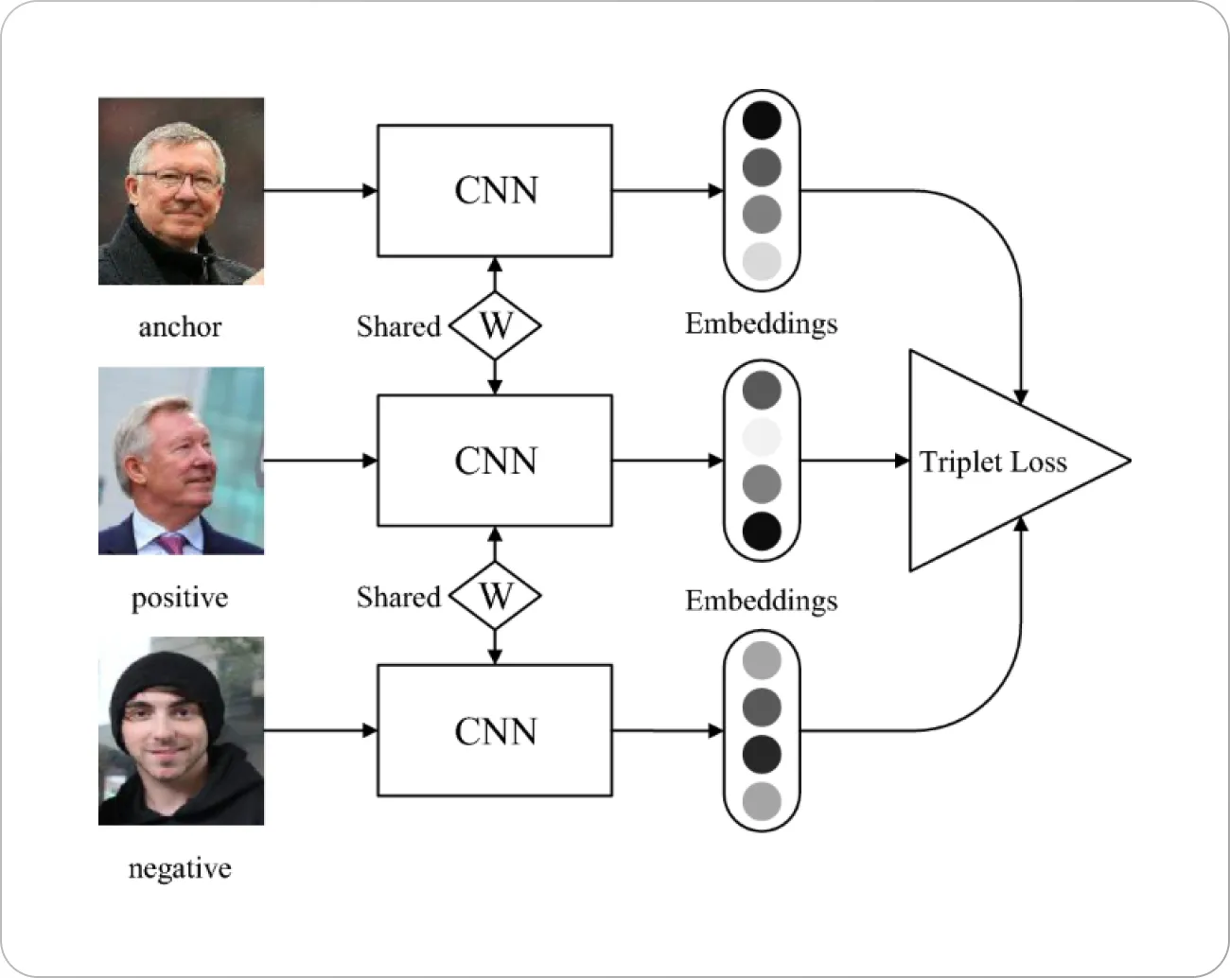
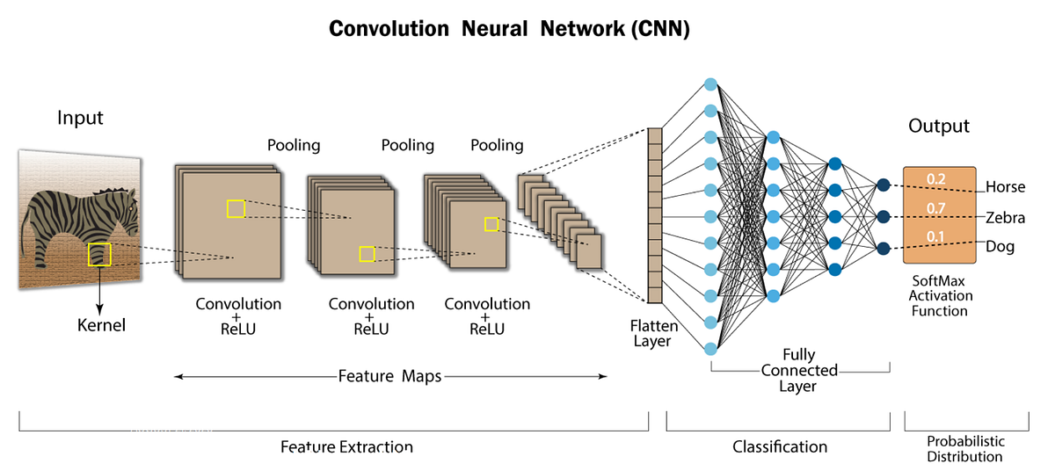
TECHNOLOGIES USED
Transformer
Fewshot Model

Slide 7
CHALLENGES FACED
Lack of Data of Good Quality
Hardware Resources: We used limited resources provided by Kaggle
Work-Task balancing : Time Management

Slide 8
FUTURE POTENTIAL ENHANCEMENT IDEAS
Classifications into Few-shot Classifications
Hardware Connection for Heart Beat Analysis
A New Module: YOLO for Diagnosis
A Rural Robot with Medical Knowledge
Incorporating GenAi
And more Sophistications

Slide 9
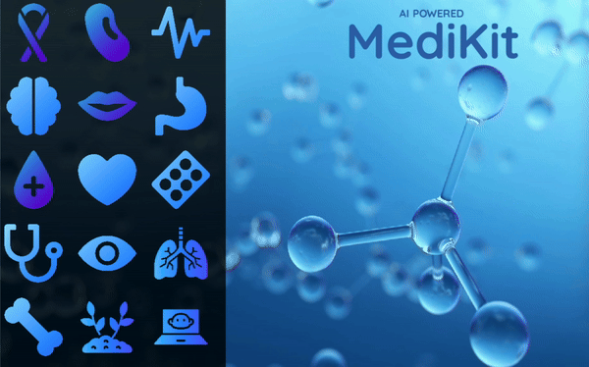

Slide 10
THANK YOU

